Slide 1
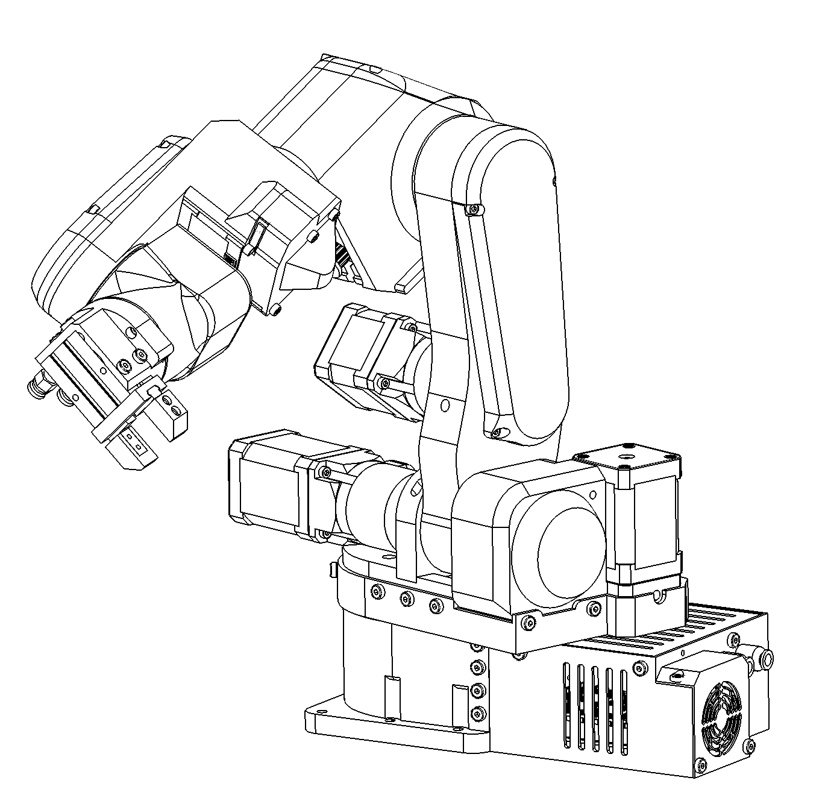
PAROL6 ASSEMBLY MANUAL
Version 1.2, rev1, date 27.10.2023

Slide 2
Disclaimer important notice
The PAROL6 robot arm and its associated part are specifically intended for engineering development, demonstration, or evaluation purposes. They are not considered to be a final product suitable for general consumer use. Individuals handling these products must have proper electronics and robotics training and adhere to good engineering practices. It should be noted that these goods may not fulfill all the required design, marketing, and manufacturing-related protective measures, including product safety and environmental considerations typically found in finished products. The PAROL6 robot arm is not compliant with the European Union directives concerning electromagnetic compatibility, restricted substances (RoHS), recycling (WEEE), FCC, CE, or UL. Consequently, it may not meet the technical requirements outlined in these directives or other related directives.
The user assumes full responsibility and liability for the correct and safe handling of the robot. Additionally, the user agrees to indemnify the Source Robotics team against any claims arising from the use or handling of the products. Given the open construction of the product, it is the user's responsibility to take all necessary precautions.
EXCEPT FOR THE INDEMNITY DESCRIBED ABOVE, NEITHER PARTY SHALL BE HELD LIABLE TO THE OTHER FOR ANY INDIRECT, SPECIAL, INCIDENTAL, OR CONSEQUENTIAL DAMAGES.

Slide 3

Disclaimer important notice
Before building this robot please read the whole manual! This machine can cause harm to you and people around you. It can burn, electrocute and physically hurt you if you are not careful. Please read these instructions carefully!
Also after reading and building this robot make sure to make yourself comfortable with robot control software and how to operate it!

Slide 4
License
Robotic arms commander software: Link, STL files: Link and control board software are licensed under GPLv3 license! PAROL6 STEP files and PAROL6 control board are not open source!

Slide 5





Assembly manual
Welcome to the PAROL6 assembly manual. PAROL6 is 6 axis robotic arm aimed for education, research and small automation. It is made by Source Robotics, designed by Petar Crnjak
All additional information can be found here:
Github project repository - most up to date BOM, parts, docs, manuals…
Docs page - latest documentation on PAROL software
Official company page - Source robotics
You can also ask help and advice from community:
Official discord server: link
Or send us an email at: info@source-robotics.com
And you can follow us on social media:

Slide 6
Assembly manual
All screws shown are same size and only for reference. For correct size read the instructions stated on the page what screw to use. Some parts are not show; mostly bearings, small screws and belts but are referenced on the page of the building instructions.
This document only shows assembly manual, all other files like BOM, printing table, STL files can be found on GitHub page of the project.
All parts should be printed with PETG material. Reference printing table for optimal infills and printing settings.
Wires are not shown but detailed instructions are given on how to route the wires.
Belts are not shown but detailed instructions are given on how to attach them correctly.
This window shows what parts you will need on this page.
This window show building instructions.
This window shows tips and notes.

Slide 7
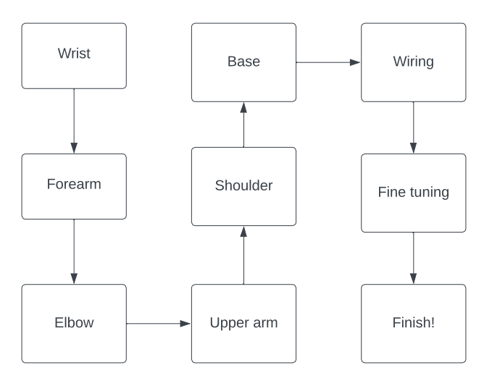
Assembly manual - Road map on building PAROL6 and using it!
Robot needs to be built from wrist to the base. That means we start by building the wrist then lower arm, elbow, upper arm and base. Any other order will not work. This needs to be done this way since all wires pass thru the the robot.
After assembling the robot it needs to be wired up to the PAROL control board. After that some fine tuning and testing can be done.

Slide 8
Assembly manual - Print preparation
Some parts need to be printed with support. Before using those parts make sure to clean all support material.
Printer settings we used:
Printer: Prusa MK2S
Material: PETG
Layer height:
Support: Reference printing table
Infill: Reference printing table

Slide 9
Assembly manual - Wire and pneumatic tube preparation
Since robot is built from the wrist to the base of the robot you will have more and more wires as you reach the end. To keep it clean and easy to assemble before adding next link wrap group of wires with insulation tape (we used cloth fabric tape). For example after finishing lower arm assembly wrap Joint 6 motor with tape, Joint 5 motors with tape… Try to use tape of different color to mark different joints. This will help you A LOT when you will need to wire up the robot. When you assemble the robot you will have more length of the wires than you need cut them so you can wire the control board and keep everything clean. Usually after the wires exit the base of the robot they need to have extra 8 cm. For tubes leave 15 cm.
Wires for gripper need to be twisted pair wires.
Try to follow these guidelines on how much wire length you need to have for every part of the robot.
Wire lengths:
Motor joint 1 - 4 wires 1 meters
Sensor joint 1 - 3 wires 1 meters
Motor joint 2 - 4 wires 1 meters
Limit switch joint 2 - 2 wires 1 meters
Motor joint 3 - 4 wires 1 meters
Limit switch joint 3 - 2 wires 1 meters
Motor joint 4 - 4 wires 1 meters
Sensor joint 4 - 3 wires 1 meters
Motor joint 5 - 4 wires 1 meters
Limit switch joint 5 - 2 wires 1 meters
Motor joint 6 - 4 wires 1 meters
Sensor joint 6 - 3 wires 1 meters
Pneumatic tubes - 2 tubes 1 meters
Gripper wires - 4 wire 1 meters (2 twisted wire pair)

Slide 10
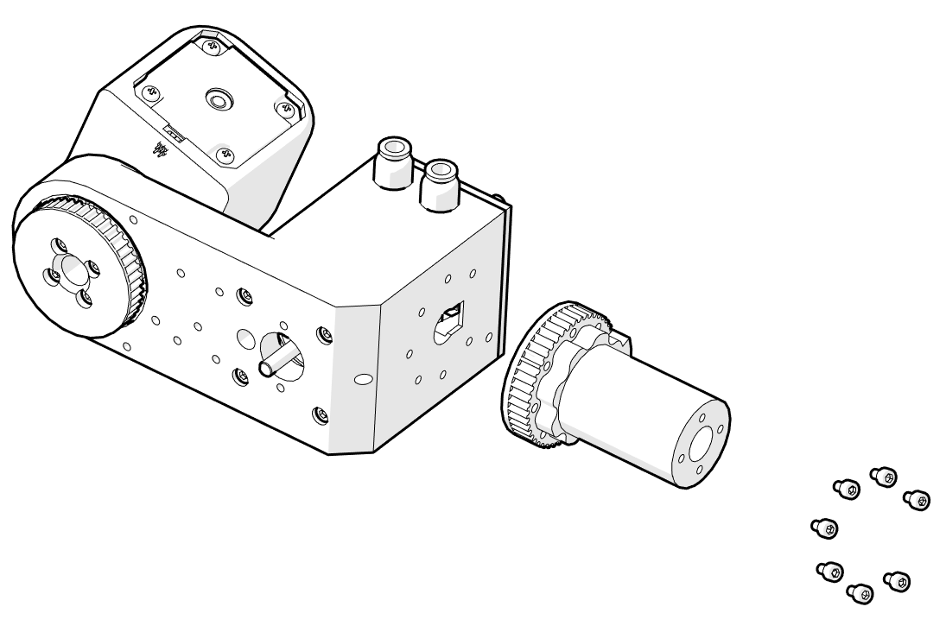
Assembly manual - Screws and attaching parts
Most metal to metal parts require no preparation. For example attaching stepper motors or gearboxes. Those parts already have threaded holes.
Attaching shaft couplers to motor shafts requires blue threadlocker. This will be discussed more, later in assembly manual. It is also recommended to apply threadlocker to any screw that pairs with metal. So any screw that connects to the motors and gearboxes
PAROL6 uses M3 -M5 screws to attach parts. Most functional print to print attachments are done with a crew and a undersized 3D printed hole.
For example on image at the right side we are attaching two 3D printed parts that will carry load and are not esthetic parts (esthetic parts are for example covers and robot will work without them). Screws are in this example M3 screws and holes are undersized to 2.7-2.8mm that means that when we screw in the screws we are tapping holes in 3D printed parts.
There are multiple benefits to this:
Connection is strongest compared to tapping holes with a tap or using brass inserts
It is simple and fast
No need to prepare the hole, it can be printed undersized
Cons are that you can't disassemble it a lot of times. In case you feel screws slipping in the hole. Put some super glue in the hole and wait for it to cure. After that re tap the hole.

Slide 11
Assembly manual - Needed tools
Tools you will need to assemble this robot:
Screwdriver set
Drill
Soldering iron
Imbus wrench (Allen key / HEX key) set
Torque screwdriver
Rubber hammer
Hammer
Pliers
For screwing we recommend using an electric screwdriver and then precision torque screwdriver or last few turns by hand. If you use drill or electric screwdriver for all the parts you risk destroying your threads.

Slide 12
Assembly manual - Needed consumable items
Blue threadlocker
Lithium grease
Insulation tape
Solder
Heat shrink tube
Wire harness
Cloth Fabric Tape

Slide 13
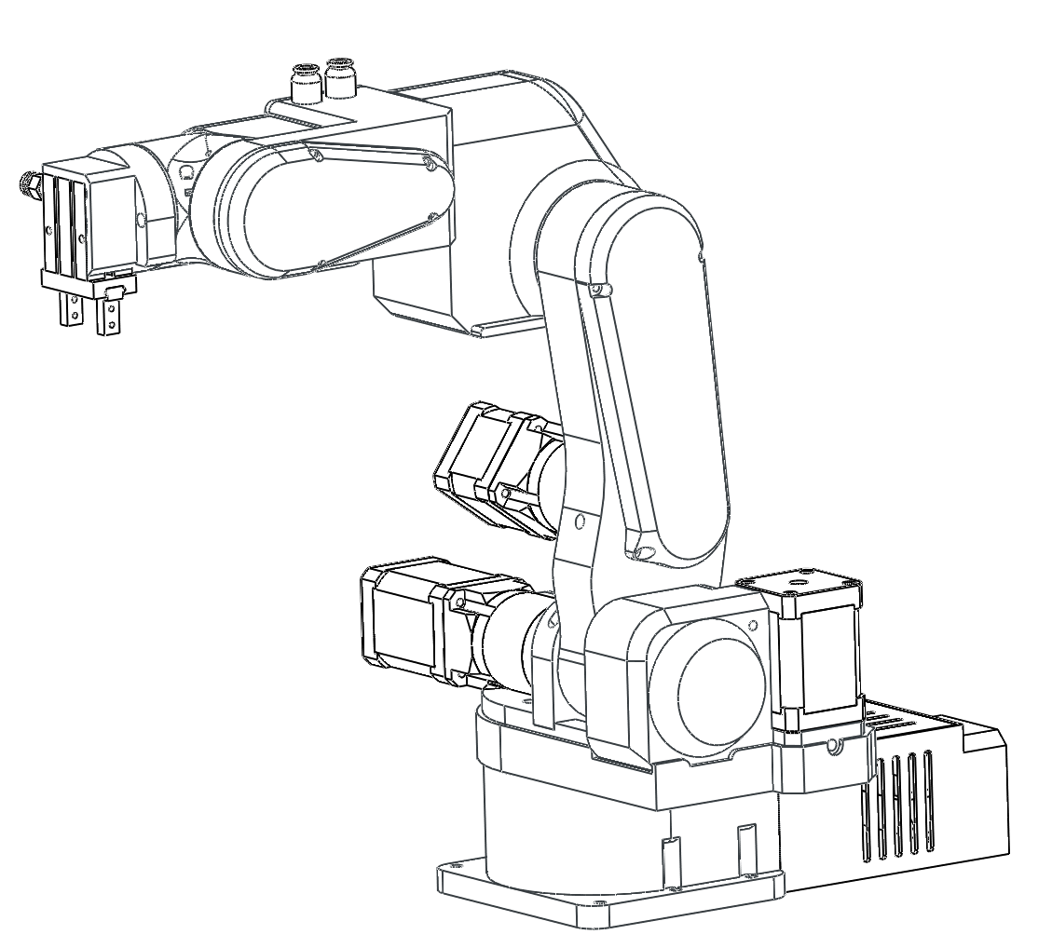
Assembly manual - Joint numbering and names
4
6
3
5
2
1

Slide 14
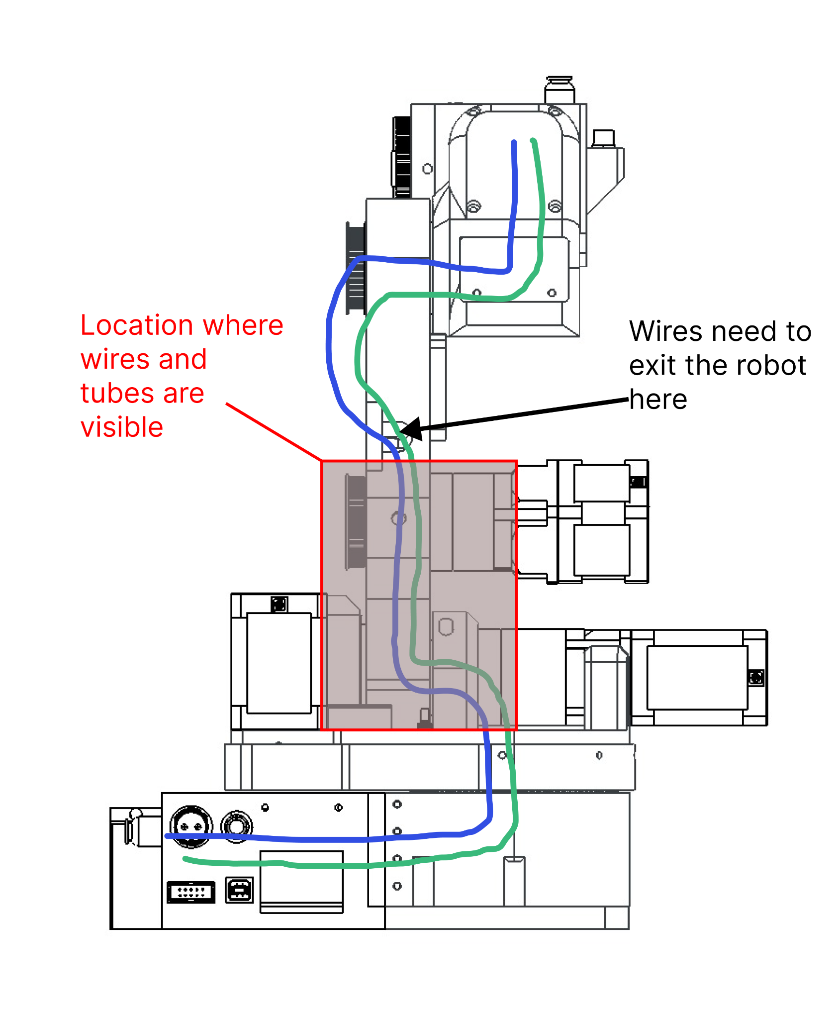
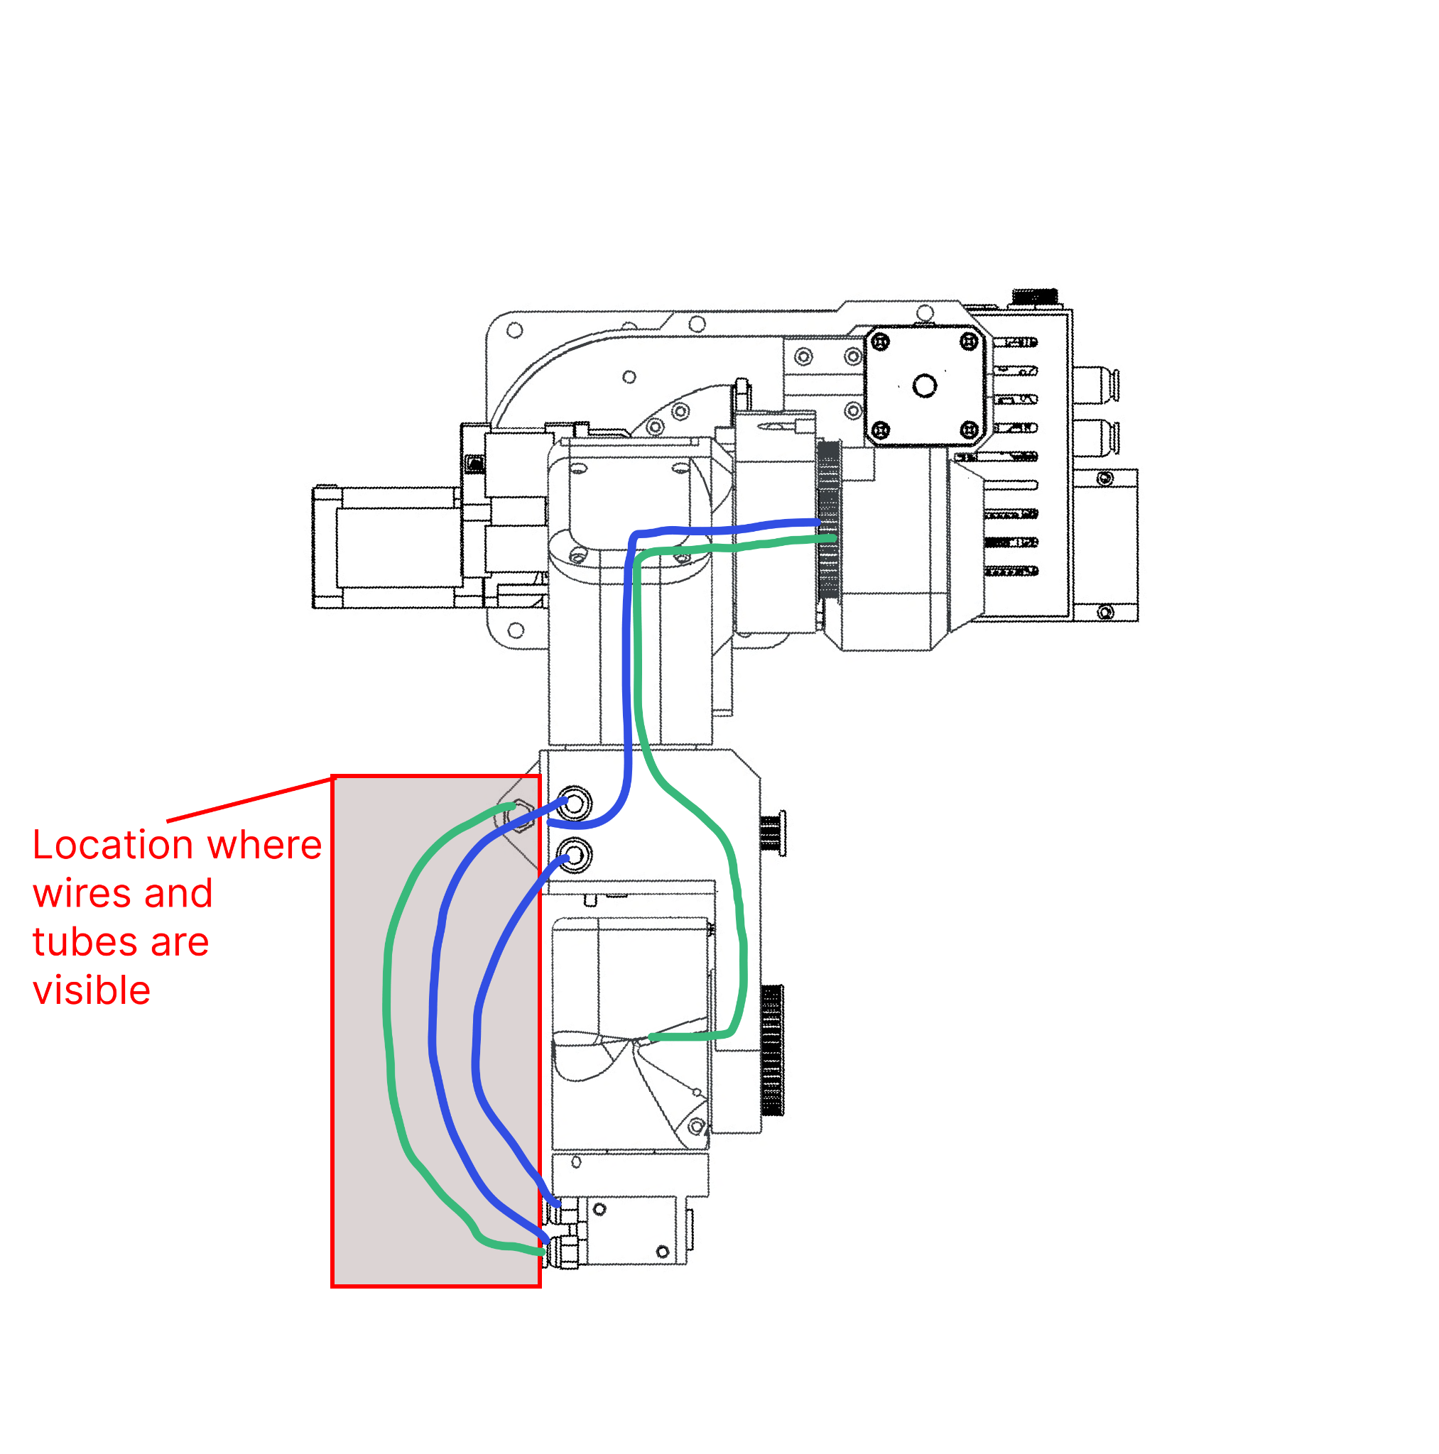
Assembly manual - Wiring
Most robot wires go thru the robot. Only the red marked areas are where robot wires are visible.

Slide 15
Preparing parts

Slide 16
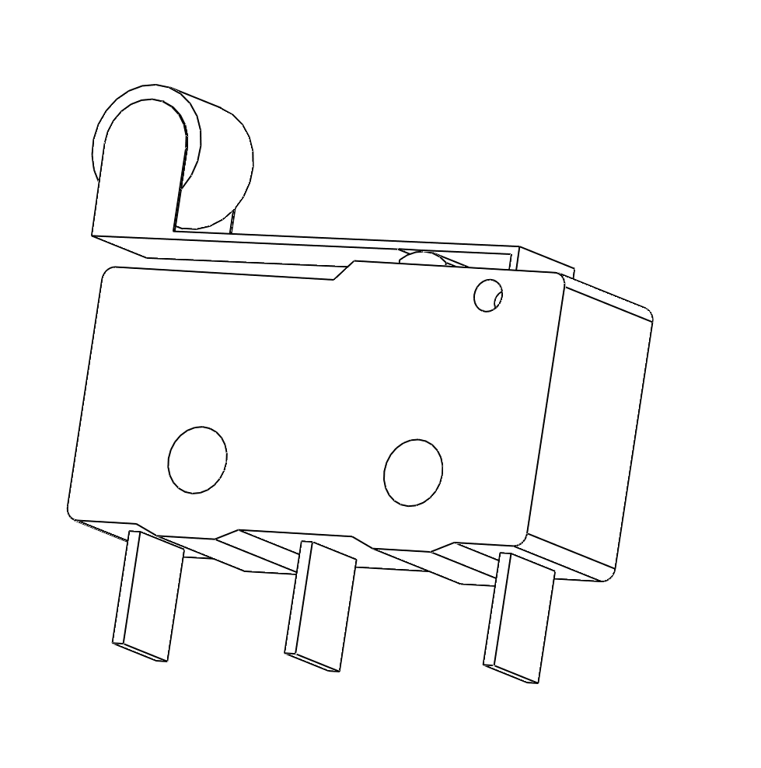
Limit switches
Attach limit switch wires to contacts indicated with orange. Apply heat shrink tube on the solder joints. Length of the wire needs to be 1 m.

Slide 17
Additional notes

Slide 18
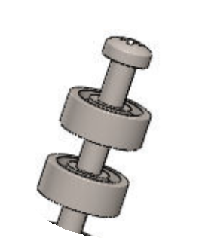
Additional notes
In case a belt is not tight enough you can always add additional tension bearings.
When assembling the robot there is a lot of wires. As you go wrap them in the one single wire harness with insulation tape or cloth tape.
If during the assembly process the tape gets in the way remove it and add it after that assembly step.
try to mark the wires so you know what is what after you built the robot.
Belt tension is done with Ball bearing 3x8x4 and Ball bearing 3x10x4 ball bearings. depending on how much tension you want you can choose any combination. They need to be 2 in pair always on a screw of 14 - 20 mm length —------------------>
It is recommended for screw to follow ISO 4762 specification.
SCREWS USED TO ATTACH GEARBOX TO MOTOR ARE THE ONES YOU GET WITH THE GEARBOX

Slide 19
Additional notes
Parol6 robotic arm needs homing since it uses open loop-stepper drivers. Joints 1,4 and 6 are homed with inductive sensors. Homing is done with small screws that trigger the sensor when it gets close to it. You need to find “sweet” spot where the sensors trigger.

Slide 20
Wrist assembly

Slide 21
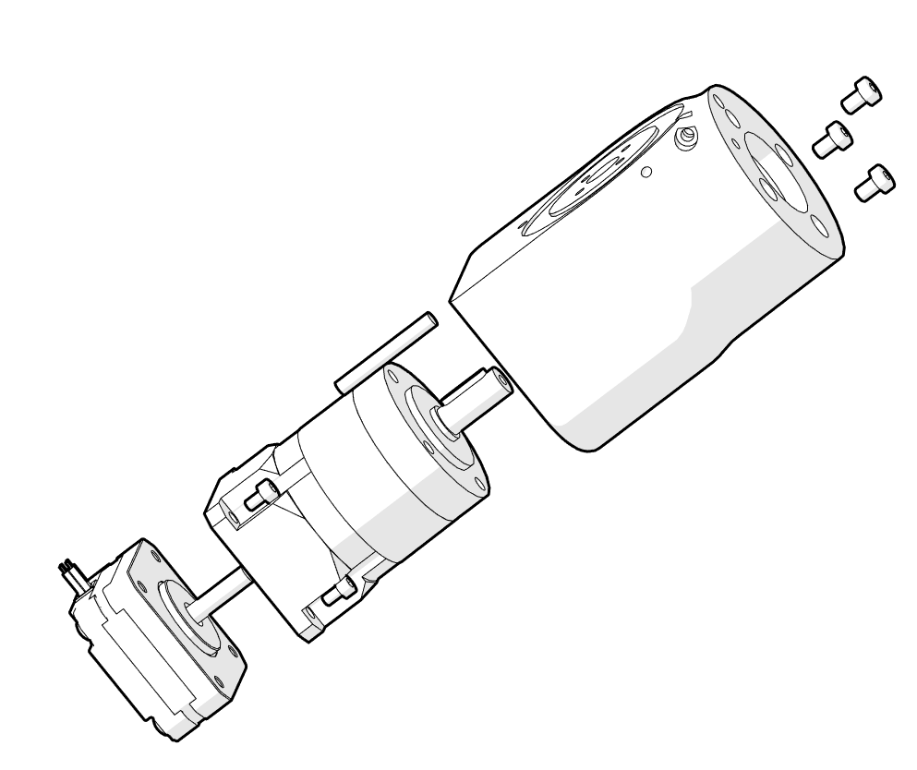
Wrist assembly
3 x M4 10mm
Wrist
Gearbox 10:1
Stepper1
Sensor1
3 x M4 10mm
4 x M3 8mm
SCREWS USED TO ATTACH GEARBOX TO MOTOR ARE THE ONES YOU GET WITH THE GEARBOX. APPLIES TO EVERY GEARBOX + MOTOR ASSEMBLY IN THIS BUILD
1
2
4 x M3 8mm
First attach stepper 1 to the gearbox. The gearbox comes with its own coupler that need to be tightened with 2 set screw. Holes to tighten those screws are on the side of the gearbox.
Now press fit sensor 1 in wrist part. It needs to lay flat on top part of the wrist as indicated by arrow 1.
Wires for the motor and sensor need to exit from the hole market with arrow 2.
Make sure the orientation of the stepper is as shown on the picture!

Slide 22
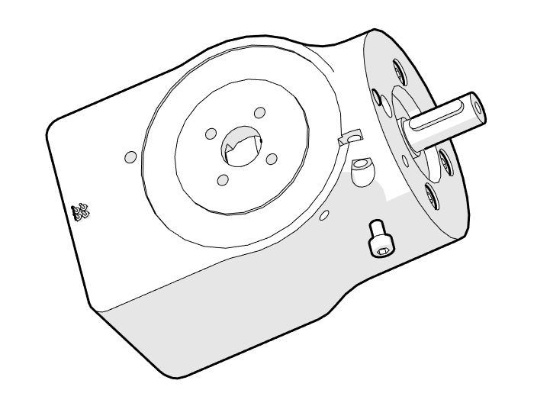
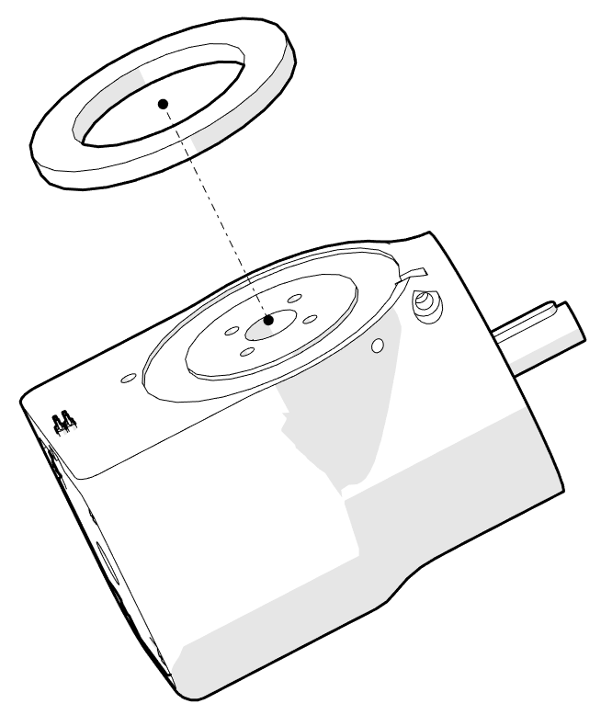
Wrist assembly
M3 14mm
If the sensor is loose you can tighten it with M3 nut and a screw.
Attach bearing 1 to wrist part.
Assembled part is on the next page.
Bearing 1
*M3 14mm
*M3 nut

Slide 23
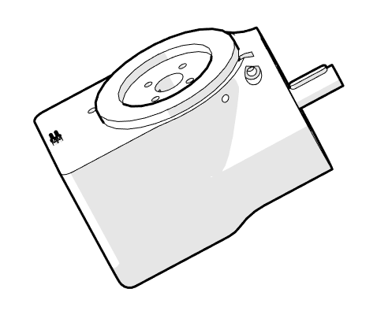
Wrist assembly
Parol6 robotic arm needs homing since it uses open loop-stepper drivers. Joints 1,4 and 6 are homed with inductive sensors. Homing is done with small screws that trigger the sensor when it gets close to it. You need to find “sweet” spot where the sensors trigger.

Slide 24
Forearm assembly

Slide 25
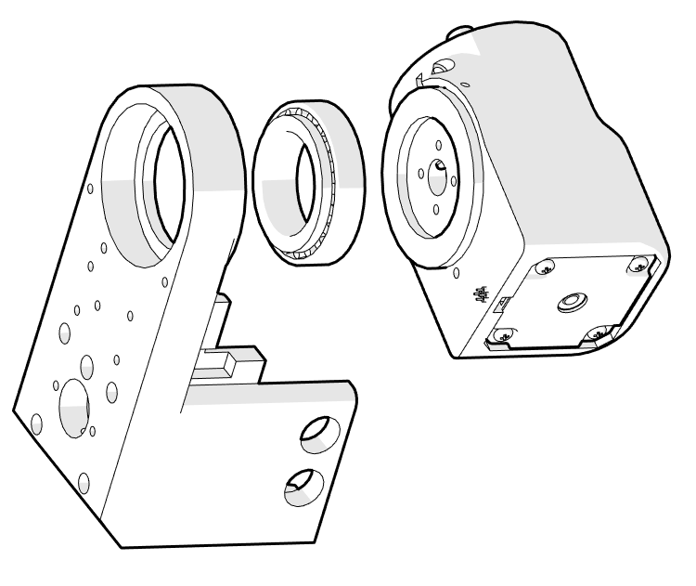
Forearm assembly
1
Bearing 2
J5_part
Bearing 2 need to go in the groove marked with arrow 1.
Assembled part is on the next page.

Slide 26
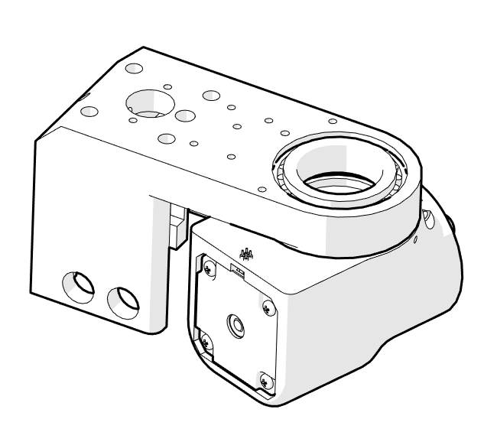
Forearm assembly
Hammer in the bearing with rubber hammer. Another option is to use screwdriver and gently tap with a hammer on the whole circumference of the bearing.

Slide 27
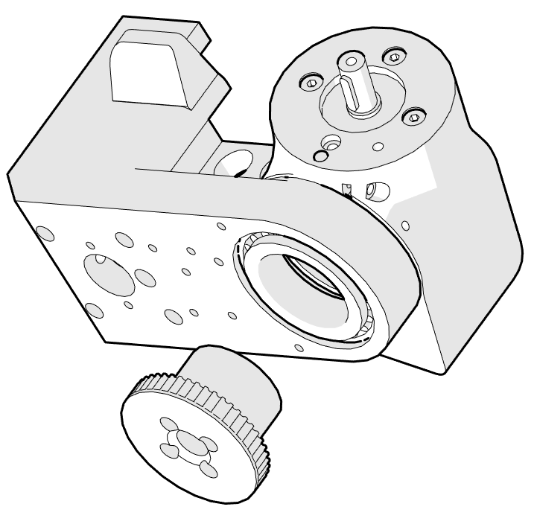
Forearm assembly
HTD3_48_J5_pulley
Pull all then wires from J6 thru the pulley and the bearing! Assembled part is on the next page.

Slide 28
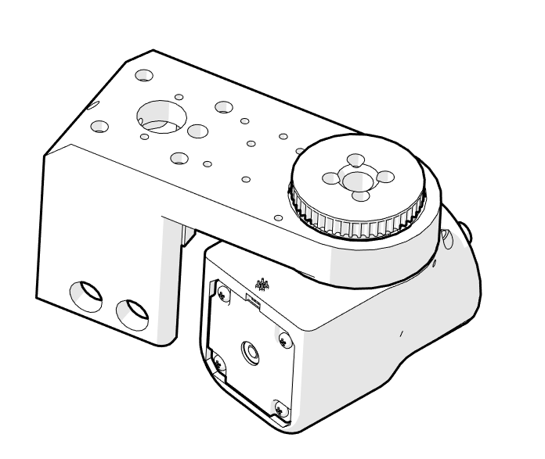
Forearm assembly

Slide 29
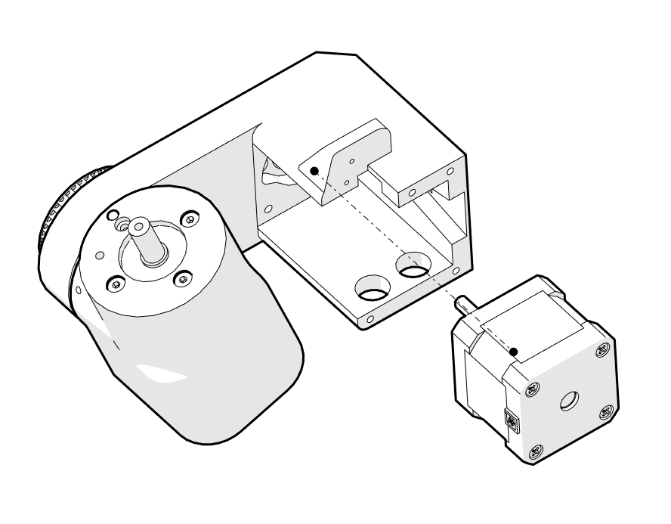
Forearm assembly
2
Stepper 2
Stepper wire, all other wires and pipes need to go thru the wires guide marked with arrow 1 and then thru a hole on J5 part.
Stepper orientation is wrong on this image. Flip it 180 degree so that wires go thru the hole where arrow 2 points

Slide 30
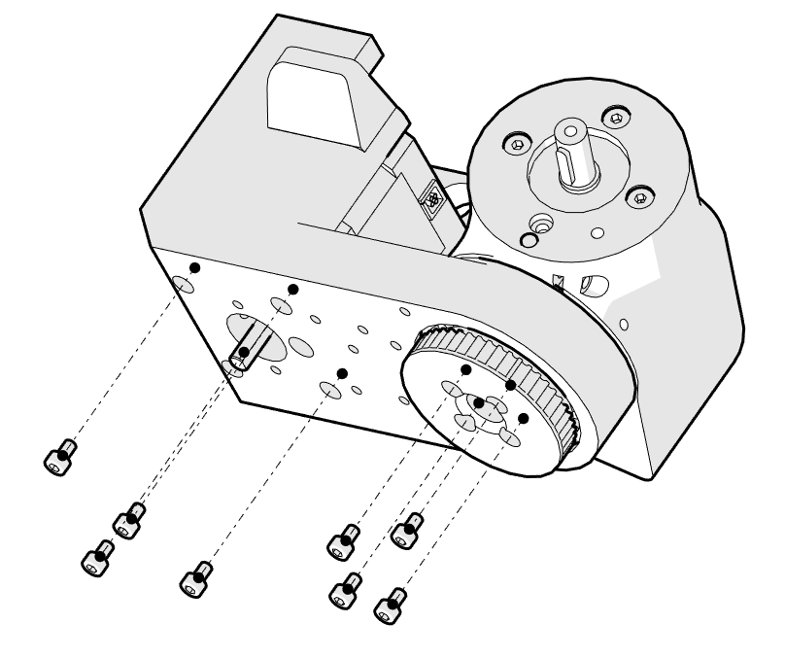
Forearm assembly
4 x M3 x 14mm
4 x M3 x 25 mm
4 x M3 x 14mm
4 x M3 x 25 mm

Slide 31
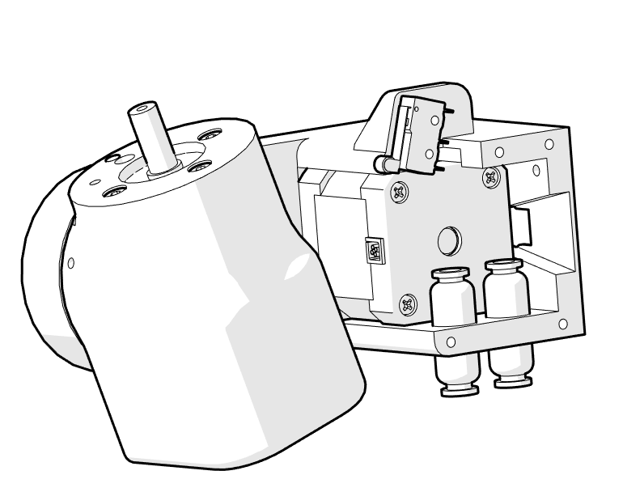
Forearm assembly
2 x Pneumatic connector 1
Limit switch
2 X M2 x 10mm
Limit switch needs to be secured with M2 screws. Wires need to go thru a hole in J5 part. Pneumatic connectors need to be secured with provided nuts.
Pneumatic tubes go thru a hole on J5 part.

Slide 32
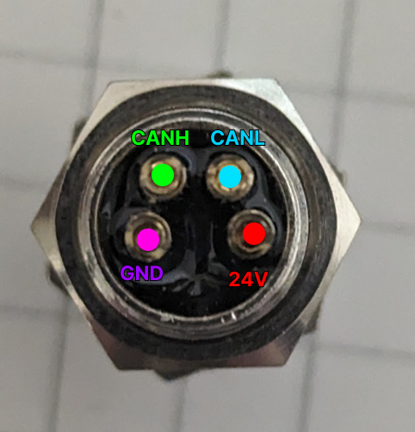
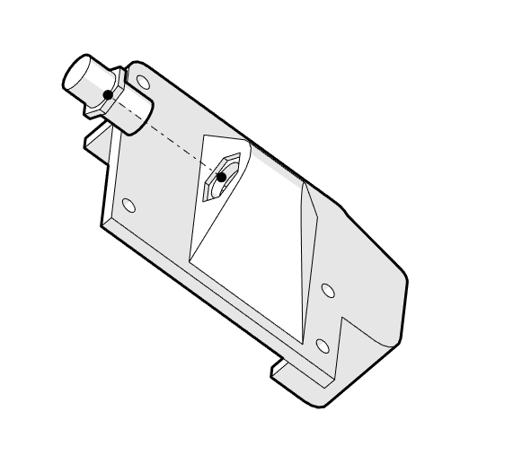
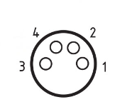
J5_electronics_lid
Gripper connector electric
Forearm assembly
On the gripper connector solder 4 wires of length 1m.
2 wires need to be twisted pair for the can bus. Use heat shrink on solder joints. After placing gripper connector in lid use provided nut to tighten connector to the lid.
Solder 4 wires to 4 pin connector. Use this pinout: 1- 24V
2- CANH
3 - GND
4 -CANL

Slide 33
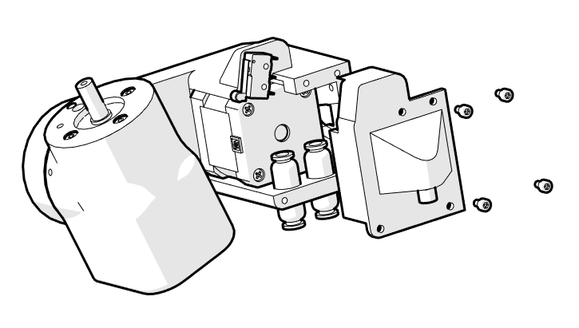
Forearm assembly
4x M3 8 mm
Assembled part is on the next page.

Slide 34
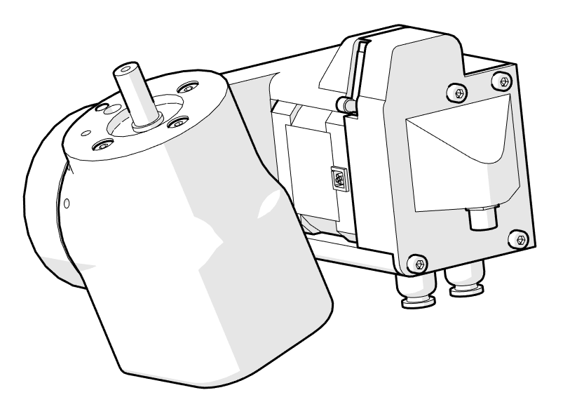
Forearm assembly

Slide 35
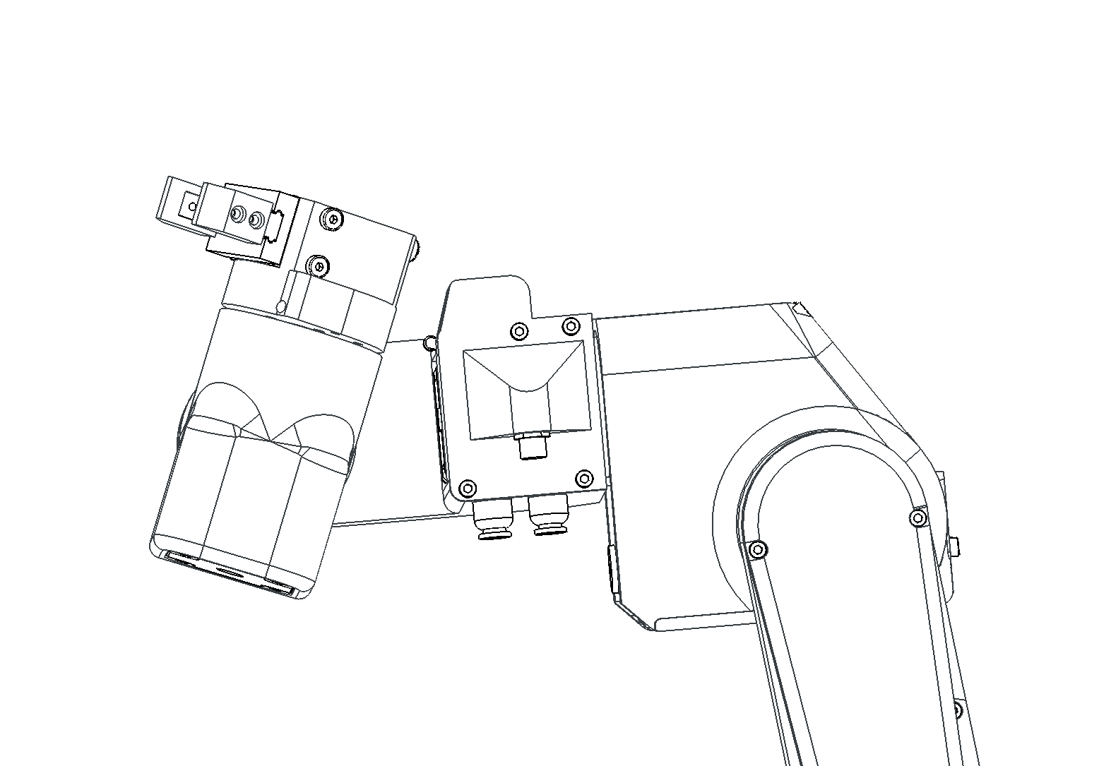
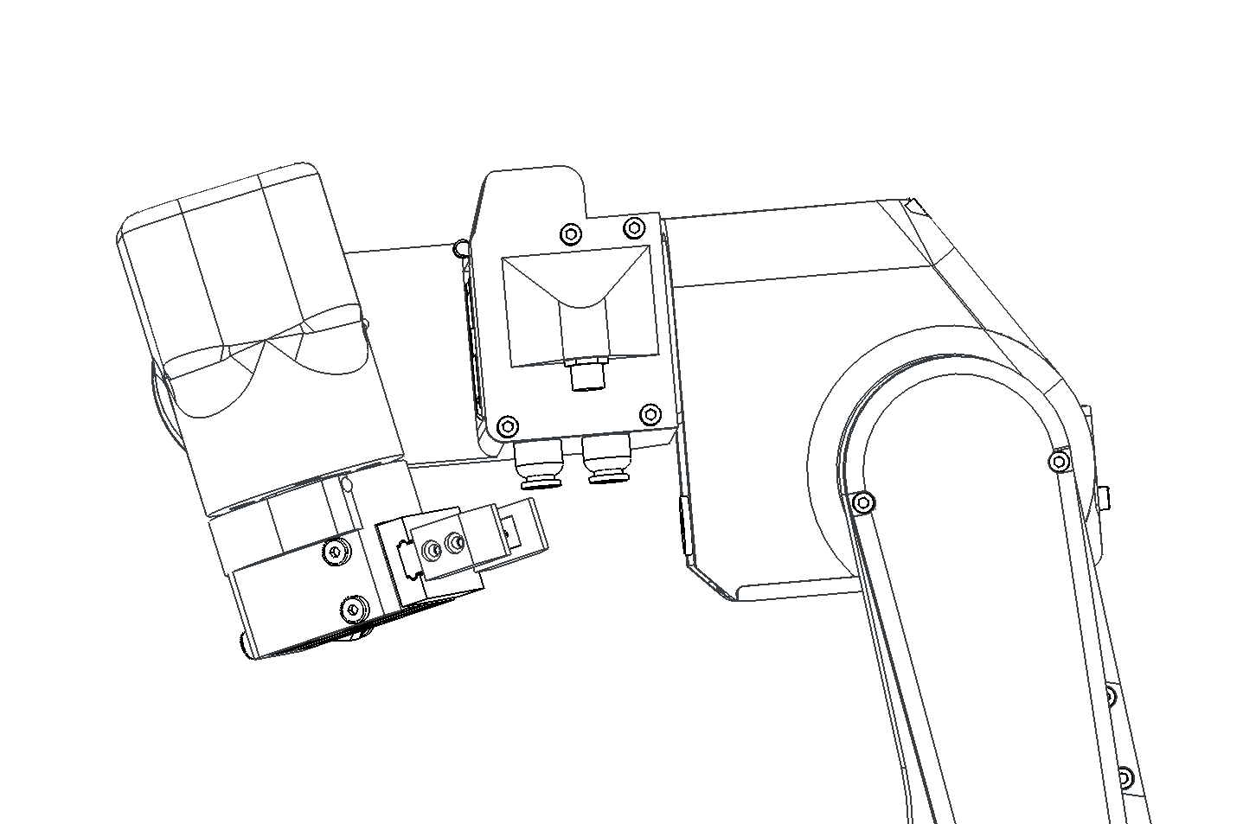
Forearm assembly
IF THERE IS NO GRIPPER ON WRIST PART IT CAN APPEAR IT CAN SPIN INDEFINITELY. DO NOT DO THAT! LIMITS OF J5 ARE SHOWN ON THE IMAGES BELOW!

Slide 36
Forearm assembly
J4_output_pulley
7 x M3 x 16mm
All wires and tubes need to go thru J4 output pulley. Assembled part is on the next page. MAKE SURE THAT HOMING PIN IS IN DIRECTION OF PNEUMATIC CONNECTORS. On this image it is wrong!
Homing pin

Slide 37
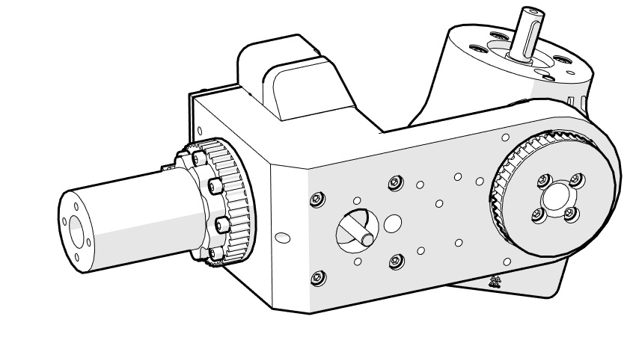
Forearm assembly

Slide 38
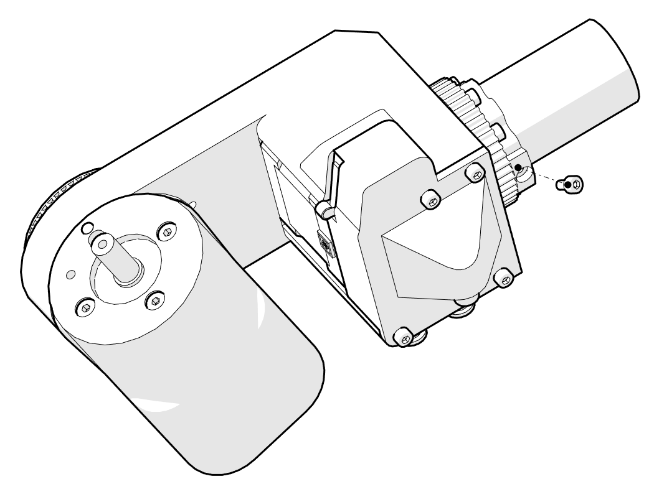
Forearm assembly
1 x M3 x 6mm
This screw is used to trigger J4 sensor. Please use provided screw. If different screw is used sensor will trigger at wrong position and mess with robot kinematics.

Slide 39
Elbow assembly

Slide 40
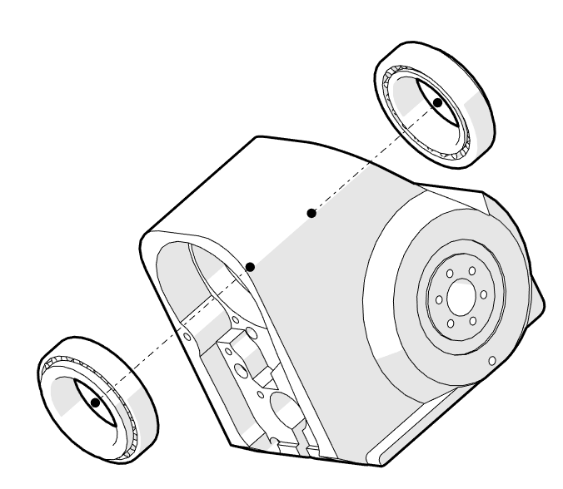
Elbow assembly
Elbow_part
2 x Bearing 2

Slide 41
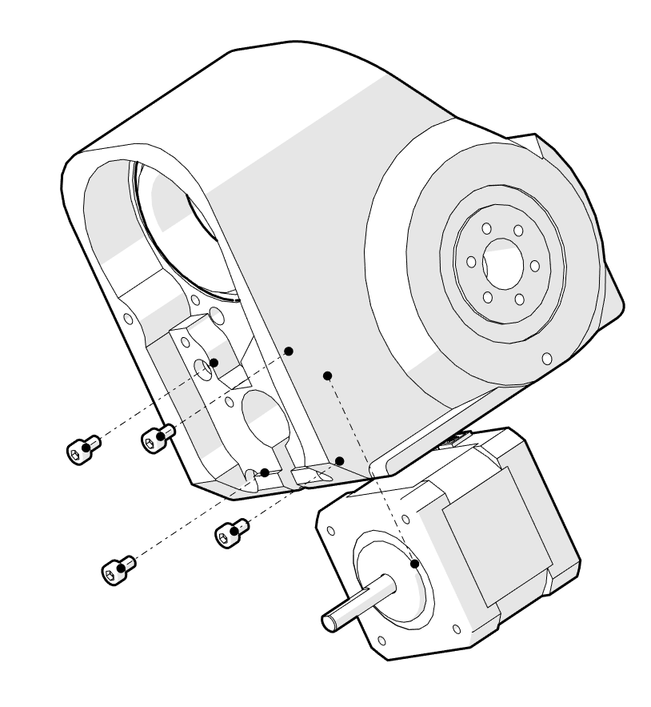
Elbow assembly
2
Stepper 2
4 x M3 x 14 mm
1
Secure the stepper with 4 screws. Note the position of stepper wires with arrow 1. All wires from previous steps and from subsequent steps need to go thru hole 2.

Slide 42
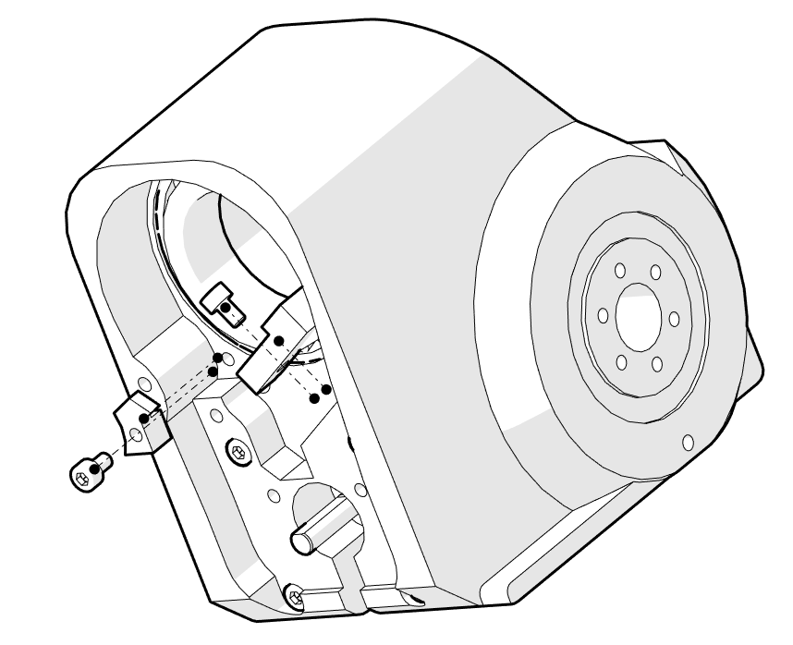
Elbow assembly
M3 x 12 mm
M3 x 8 mm
J4_limiter
Sensor 2
M3 x 12 mm
M3 x 8 mm
Wires of the sensor 2 need to go thru a hole marked with arrow 1. Assembled part is on the next page.
1

Slide 43
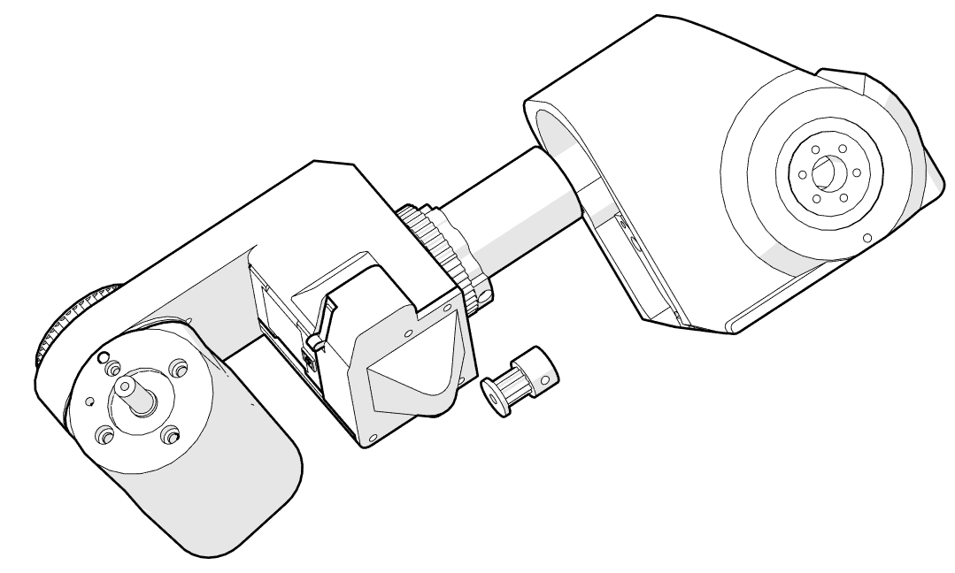
Elbow assembly
J4 pulley
J4 belt
First pull all wires and tubes thru the elbow part!
When J4 pulley and J4 output pulley are in illustrated position put the belt on.

Slide 44
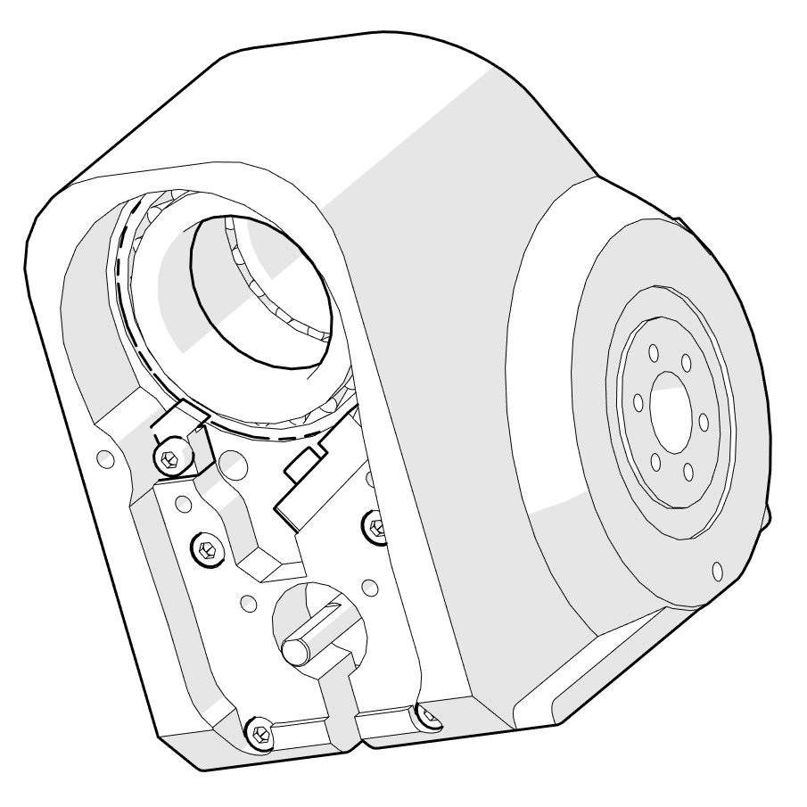
Elbow assembly
Parol6 robotic arm needs homing since it uses open loop-stepper drivers. Joints 1,4 and 6 are homed with inductive sensors. Homing is done with small screws that trigger the sensor when it gets close to it. You need to find “sweet” spot where the sensors trigger.
Belt tension bearings go the the red marked spots! USE M3x15 mm screws with tapered head!

Slide 45
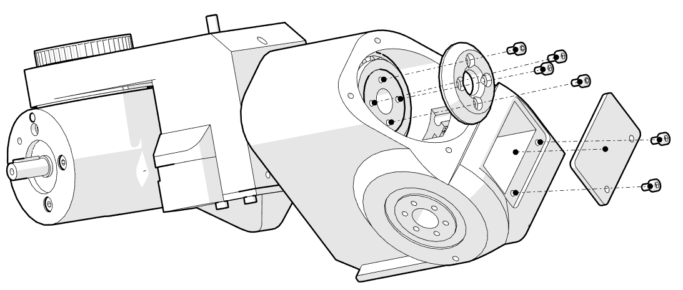
Elbow assembly
1
M3 14 mm
Elbow_lid_2
J4_bearing_backplate
2 x M3 8 mm
4 x M3 14 mm
All wires and tubes need to go where arrow 1 is pointing and exit where arrow 2 is pointing.
M3 8 mm
2

Slide 46
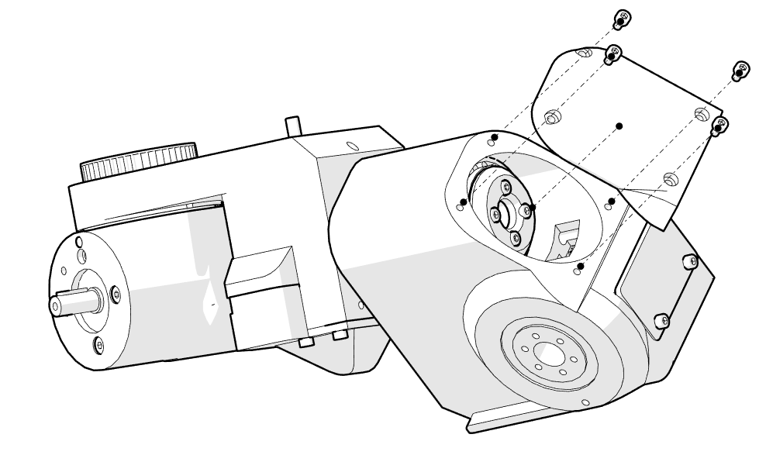
Elbow assembly
Elbow_lid_1
4 x M3 IMBUS 8 mm

Slide 47
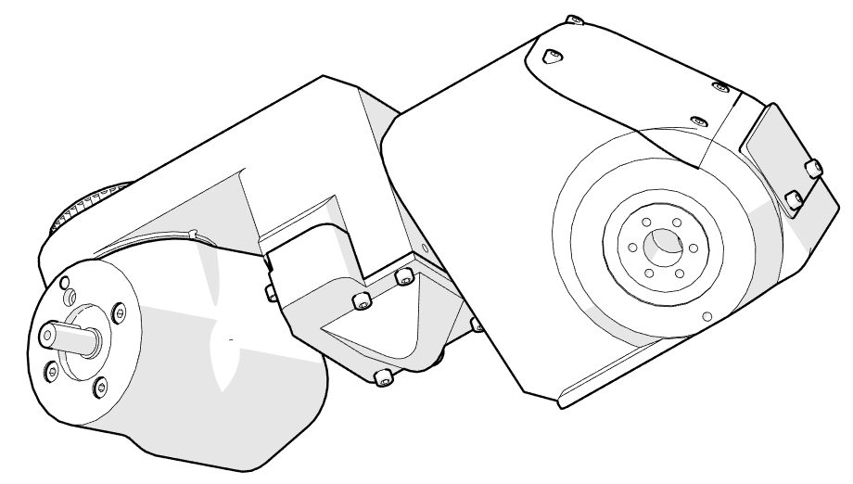
Elbow assembly
Make sure that all joints can move and that there is not much friction on specific spots. If there is you have:
Misaligned bearings
Used too much torque on bearing retainer screws.
Tangled wires.

Slide 48
Upper arm assembly

Slide 49
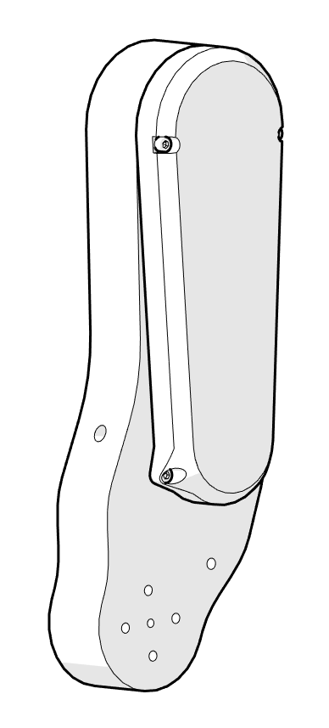
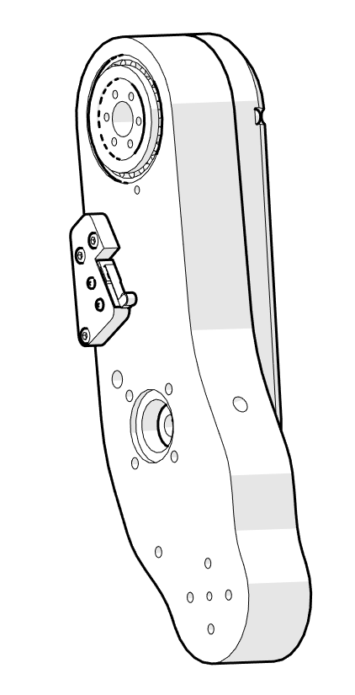
Upper arm assembly

Slide 50
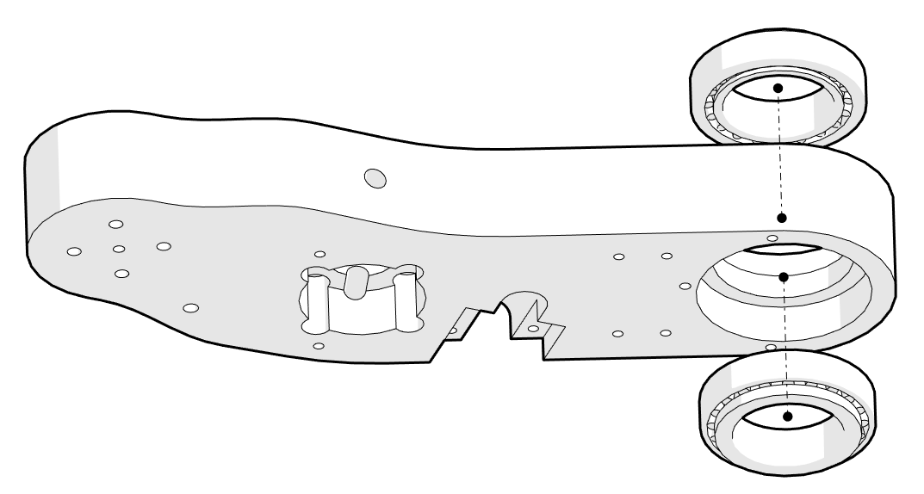
Upper arm assembly
2 x Bearing 2
Upper arm
Assembled part in the next page.

Slide 51
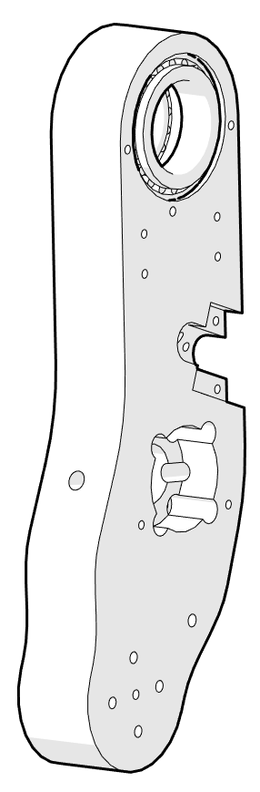
Upper arm assembly

Slide 52
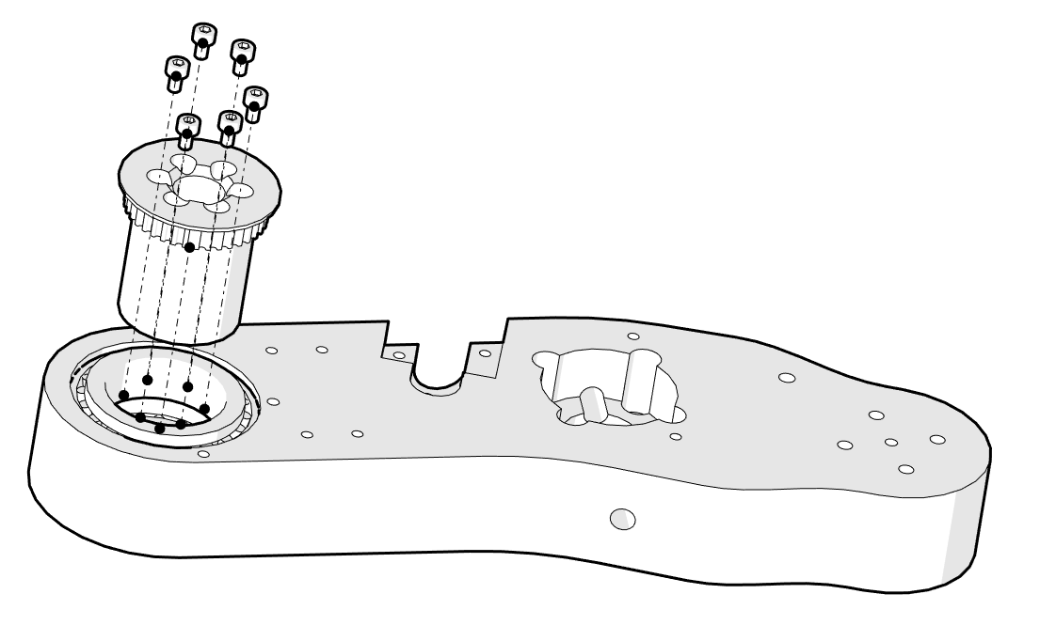
Upper arm assembly
38_pulley_J3
6 x M3 35mm or 38mm

Slide 53
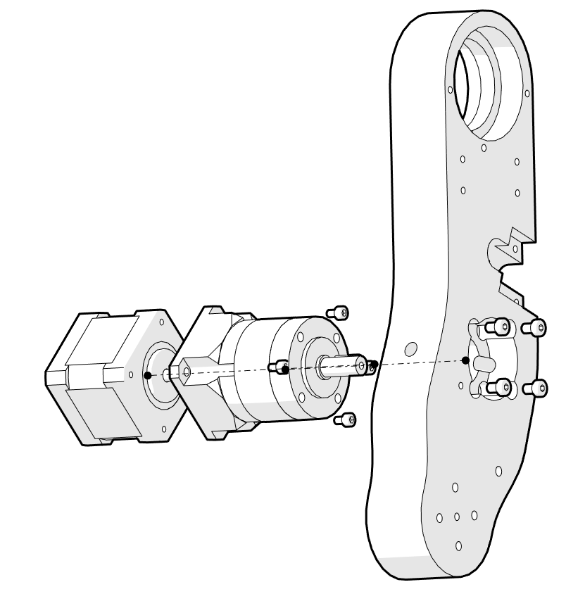
Upper arm assembly
Stepper 2
Gearbox 20:1
4 x M3 8 mm
4 x M4 16 mm
4 x M3 8 mm
Make sure that that location of the stepper side with wires is as pointed by the arrow!
4 x M4 16 mm

Slide 54
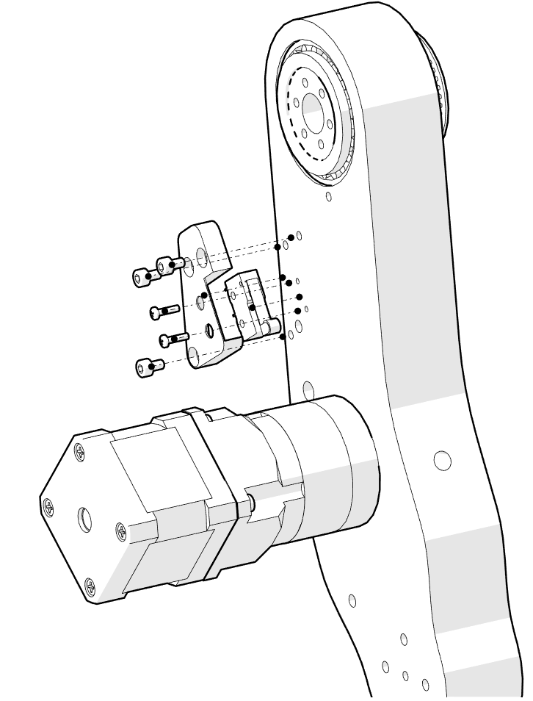
Upper arm assembly
J3_limit_switch_cover
Limit switch
3x M3 8 mm
2x M2 x 10 mm
1
2
Limit switch wires go thru hole market with arrow 1. Stepper wires go thru a hole marked with 2. Finished part on next page.

Slide 55
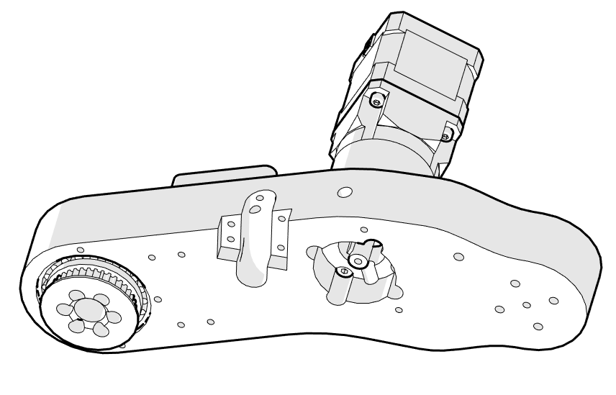
Upper arm assembly

Slide 56
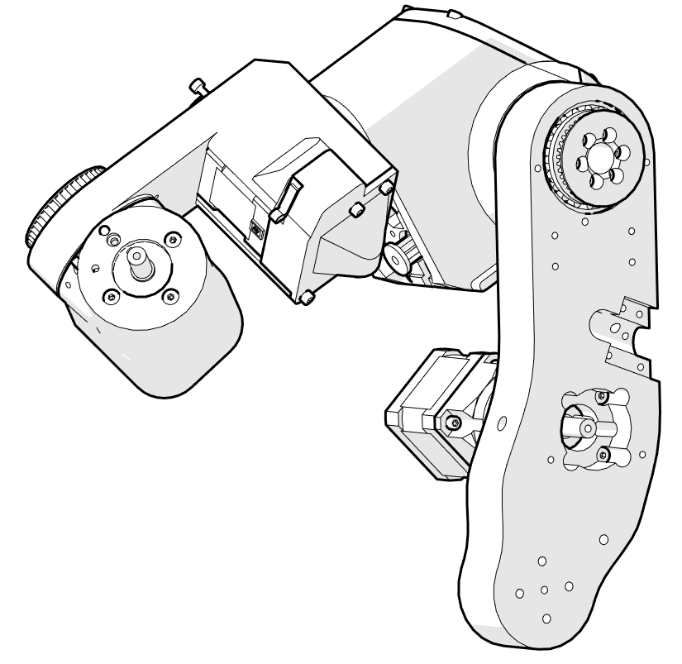
Upper arm assembly
1
Attach Upper arm assembly to the Forearm assembly. Wrap the wires with cloth fabric. Wires need to go thru the hole pointed by arrow 1 to the slot pointed by arrow 2. Wires need to follow the blue line.
*Note that you need to pull wires from J3 limit switch and J3 stepper thru the same slot!
2

Slide 57
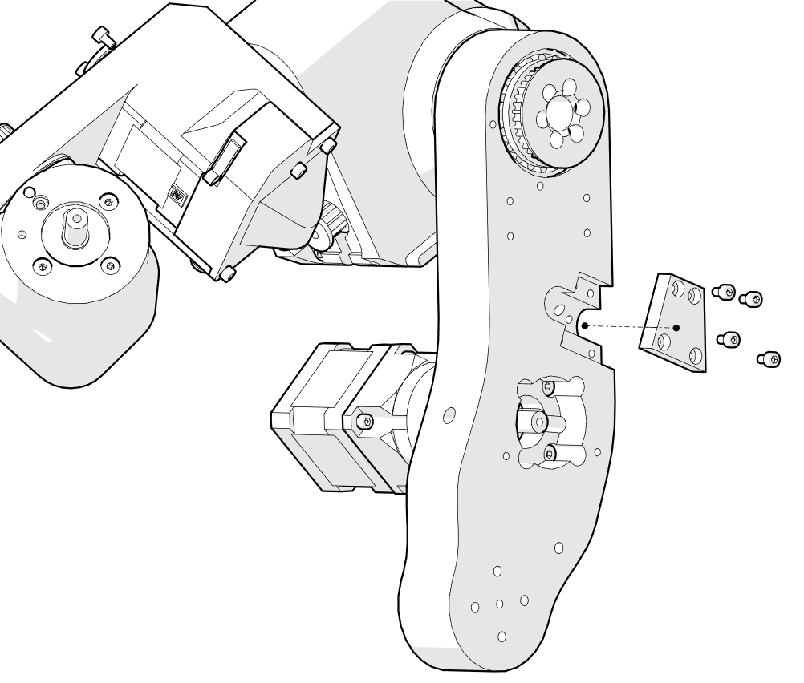
Upper arm assembly
Upper_arm_wires_cover
4 x M3 12 mm
Enclose the wires by upper arm wires cover. Make sure the wires are tight. Assembled part on next page

Slide 58
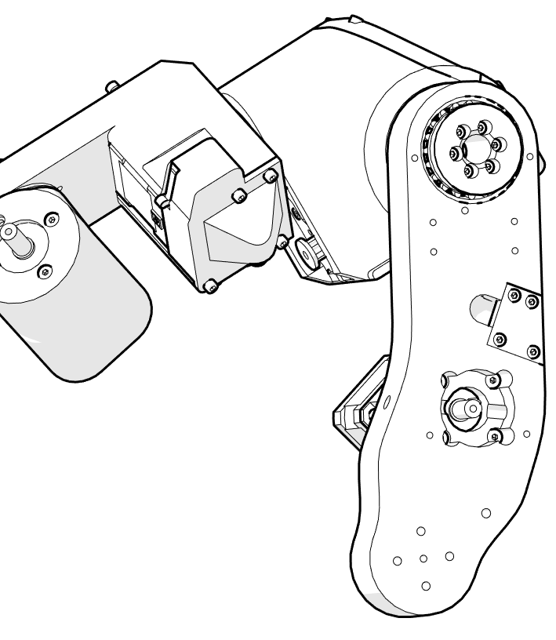
Upper arm assembly
We will attach the belt in later steps!
Once the wires are enclosed try to move joint 3.

Slide 59
Shoulder assembly

Slide 60
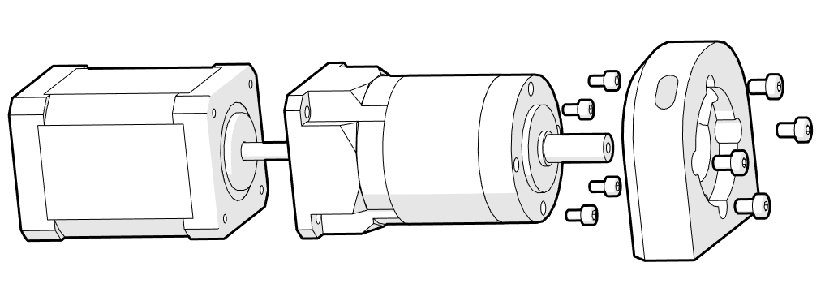
Shoulder assembly
J1_turret_motor_holder
Stepper 3
Gearbox 20:1
4 x M3 8 mm
4 x M4 16 mm
4 x M4 16 mm
First attach the stepper to the gearbox. After that attach turret holder to the gearbox.Assembled part is on the next page.
4 x M3 8 mm

Slide 61
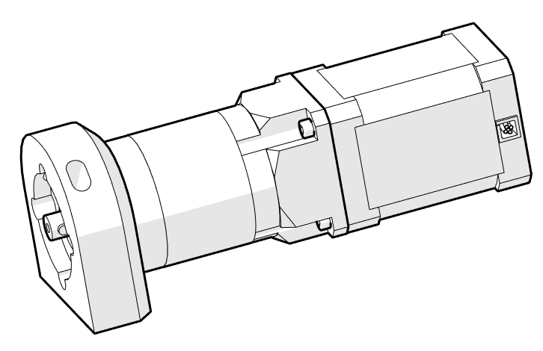
Shoulder assembly
Stepper wires need to be positioned like this

Slide 62
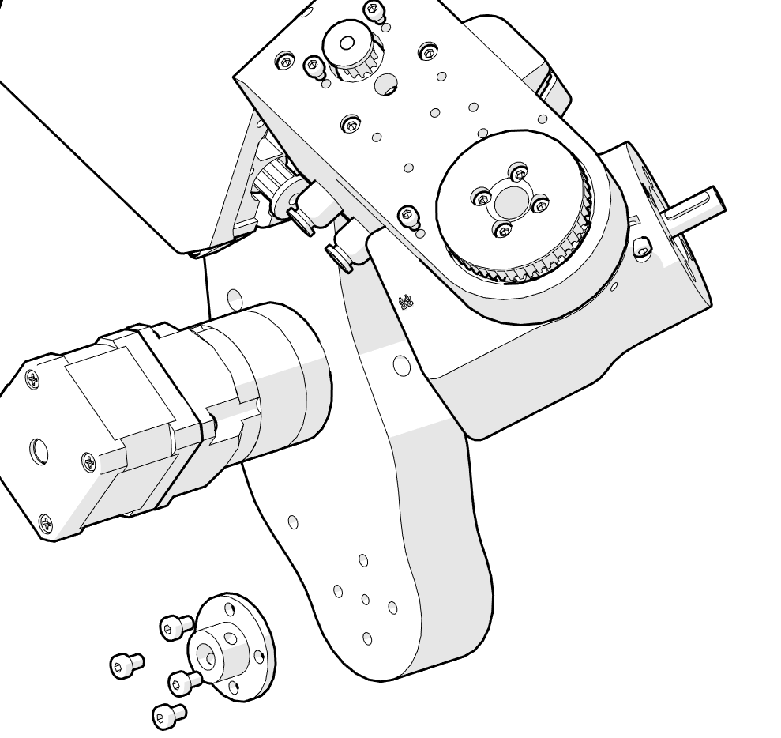
Shoulder assembly
Shaft coupler
4 x M4 16 mm
Note the position of the hole marked with 1. It is important for it to be positioned this way for easier screw tightening.
1
4 x M4 16 mm

Slide 63

Shoulder assembly
Gearbox has a hole (keyway) where key should be going. Since we are not using keys make sure that the screw of shaft coupler goes in the keyway! Use threadlocker here!

Slide 64

Shoulder assembly
M4 14 mm - used for homing J1
J1_turret
J1_rotation_shaft
6 x M4 16 mm
1 x M4 14 mm
M4 14mm screw is used to home J1. It needs to be peeking out a little on the bottom side after you screw it in. Do not screw it in all the way!

Slide 65

Shoulder assembly
Note the position of wires
Stepper 3
Limit switch
J2_limit_switch_cover
2 x M3 8 mm
4 x M3 14 mm
2 x M2 10 mm
Before placing the lid attach limit switch with 2 M2 screws. After that pull its wires thru J1 rotation shaft.
Secure limit switch with 2 M2 10mm screws.

Slide 66

Shoulder assembly

Slide 67

Shoulder assembly
J2_stopper_block
1 x M3 8 mm
2 x M3 12 mm

Slide 68

Shoulder assembly

Slide 69

Shoulder assembly
2 x Bearing 3

Slide 70

Shoulder assembly

Slide 71

Shoulder assembly
2 x M4 16 mm
2 x M4 14 mm
J1_turret is modified in new versions to have guide rails for stopper for J1.
M4 14 mm
M4 16 mm

Slide 72

Shoulder assembly

Slide 73

Shoulder assembly
1 x M3 ?
This step is not necessary!

Slide 74

Shoulder assembly
J2_shaft
4 x M4 x 50 mm

Slide 75

Shoulder assembly
J2_bearing_backplate
J2_cover
4 x M3 12 mm
J2_cover and bearing_backplate have threads.

Slide 76

Shoulder assembly
J1_belt_cover
J1_wires_cover
M2 x 10 mm
Pull the wires from stepper for J1 thru the holes on the J1_belt_cover. After that pull the wires thru the J1_rotation shaft!
J1_belt_cover does not get screwed in on this stage! Attach wires cover with 2 M2 screws.

Slide 77

Shoulder assembly
Now pull all the rest of the wires thru the J1 rotation shaft!

Slide 78
Base assembly

Slide 79

Base assembly
Main_base
2 x bearing 3
Sensor 3
1 x M3 25 mm
Parol6 robotic arm needs homing since it uses open loop-stepper drivers. Joints 1,4 and 6 are homed with inductive sensors. Homing is done with small screws that trigger the sensor when it gets close to it. You need to find “sweet” spot where the sensors trigger.
Sensor 3 needs to be in level with the main base. Screw it in with provided nuts, one from each side.
In the hole marked with red attach M3 20mm screw all the way. It is used as a rotation limiter for J1.
IF YOU DON'T HAVE ROTATION BLOCKER IN PLACE YOU RISK DAMAGING YOUR ROBOT BY DOING MORE THAN 1 ROTATION IN THE BASE OF THE ROBOT!

Slide 80

Base assembly
J1 pulley
J1 belt
Place J1 belt in position. Pull all the wires thru the base part (except J1 sensor) . After that slowly put the base all the way up to the J1 rotation shaft. Belt at this stage needs to be around base. After that you can screw in the covers and attach the pulley. Pulley has set screw holes on its side same as the cover part.
If needed add belt tension bearing on the red spot.

Slide 81

Base assembly
J1_backplate
6 x M4 16 mm
Pull all the wires (Except J1 sensor) thru the J1 backplate.

Slide 82

Base assembly
All robot wires need to go thru hole 1 and 2. To keep wiring mess to a minimum and reduce strain on the wires use this guide:
Hole 1:
J1,J3,J5 Steppers
Limit 6,2,1,5
Hole 2:
J2,J4,J6 Steppers
Limit 6,3,4, CAN
Pneumatic tubes
2
1

Slide 83

Base assembly
PAROL6 control board You can buy PAROL6 control board at: https://source-robotics.com/products/parol6-control-board Or send us an email at info@source-robotics.com
Position the board like shown in the picture. Wire the robot by following these wiring instructions or ones in the docs!

Slide 84

Wire the robot using the image on the left. For the stepper motors it is important to wire phases A and B correctly but if you switch the wires on one phase ex. phase A+ and A- it is not important since this will be taken care in the software. For limit switches orientation is also not important (one lead to 24V other to signal. For Inductive sensors.
Black - signal
Blue - negative
Brown - positive

Slide 85
Connect CAN gripper connection wires to the 24V and GND of the POWER connection (marked with red arrow). Connect CANH and CANL gripper connection wires to the CAN1H and CAN1L of the CANBUS connector marked with blue arrow.

Slide 86

Base assembly
Electronics case
8 x M3 12 mm
Slide the electronics case from the bottom of the board. Secure it to the robot with 8 x M3 screws. Remove the terminals from the green connector next to the USB.

Slide 87

Prepare the wires
On/off button
JST PH 2.0mm 4pin wire
Attach JST wire to the button following the colour markings. Only follow it if you have exact same wire and button. Length of the JST cable needs to be 80 mm!

Slide 88

Prepare the wires
GX16 2PIN
xt30 female connector
Attach GX16 2PIN male connector with at least 110 mm wire to the xt30 female connector! MAKE SURE YOU FOLLOW THE POLARITY AS SHOW ON THE IMAGE!

Slide 89

Base assembly
2 x Pneumatic connector 1
On/Off button
Power connector
8 x M3 8 mm
Pneumatic tubes after they exit the base of the robot need to be at least 150mm long! If needed shorten cooling fan wires. Also make note of the polarity of the fan!

Slide 90

Base assembly
Lid_electronics
Fan cover
Cooling fan
2 x M3 8 mm
Attach cooling fan using provided screws. Fans wires need to shortened if they are too long. Depending what fan you use; it may come with different set of screws.
When connecting power to your robot (24V) PAY ATTENTION HOW YOU WIRED THE CONNECTOR!

Slide 91

Base assembly
Bottom lid
3 x M3 8 mm; 2 mm head height

Slide 92

Attaching J5 belt
J5 Pulley
J5 belt
Attach the belt between J5 pulley and HTD3_48_J5_pulley

Slide 93

Attaching J3 belt
4 x 3x8 mm bearing
42_pulley
Shaft coupler
4 x M4 10mm
Attach shaft coupler to the pulley with 4 M4 10mm screws.
Gearbox has a hole (keyway) where key should be going. Since we are not using keys make sure that the screw of shaft coupler goes in the keyway! Use threadlocker here!

Slide 94


Attaching joint covers
2 x M3 12 mm
2 x M3 8 mm
8 x M3 14 mm
8 x 4x8x3 ball bearing
For belt tension use 2 bearings on M3 14 mm screw. Do that on each side of the belt
Tension bearings Use M3 14 mm screws
M3 12 mm
Tension bearings Use M3 14 mm screws
M3 14 mm
M3 8 mm

Slide 95

Pneumatic gripper
Shaft coupler
4 x M4 10mm
Pneumatic gripper holder
M3x 14mm screw
Attach shaft coupler to the pneumatic gripper holder. Make sure to align holes of the shaft coupler for set screws with the ones on the pneumatic gripper holder.

Slide 96

Pneumatic gripper
M3x 14mm screw
Pneumatic gripper
4 x M4 10mm
Attach gripper to the holder with 4 M4 screws. Add pneumatic connectors to the gripper if they are not installed. Install homing screw (M3 x 14mm) to the hole marked with arrow. Make sure that homing screw triggers the sensor.
Screw in the set screws on the shaft coupler.

Slide 97

Estop assembly
4x M3x 25mm screw
Estop Estop bottom
Estop top
Cable gland PG7
4 x M3 brass inserts

Slide 98

SSG48 gripper
If you want to build SSG electric gripper to use with your PAROL6 check this guide: https://github.com/PCrnjak/SSG-48-adaptive-electric-gripper

Slide 99

Great job!
Go to the docs to get your robot up and running! https://source-robotics.github.io/PAROL-docs/

